Slide 1
Untangling The ALS X-Files
Disclosures:
Research support from ALSA, MNDA, Cytokinetics, GSK, Ultragenyx, Orion
Consulting support from ALSA, Cytokinetics, Mallinkrodt, Brainstorm, MT Pharma
Richard Bedlack MD PhD
Duke ALS Clinic
Durham NC, USA

Slide 2

The Original X-Files
TV show, 1993-2002; 2016-2018; Movies
Fox Mulder
  Baby sister Samantha disappeared
    Aliens?
  Spends the rest of his life trying to prove that aliens and other supernatural creatures are real
Each episode would open with a strange occurrence
    Usually a rational explanation
http://en.wikipedia.org/wiki/The_X-Files

Slide 3
“Samantha”
60 year old university professor, newly diagnosed with clinically definite sporadic ALS. She currently has minimal bulbar weakness, moderate arm and leg weakness. No obvious cognitive or behavior problems
Following education about the disease itself, she is presented with stage-appropriate, evidence-based management options including Riluzole, multi-disciplinary team care
She is also asked about participating in a research study

Slide 4
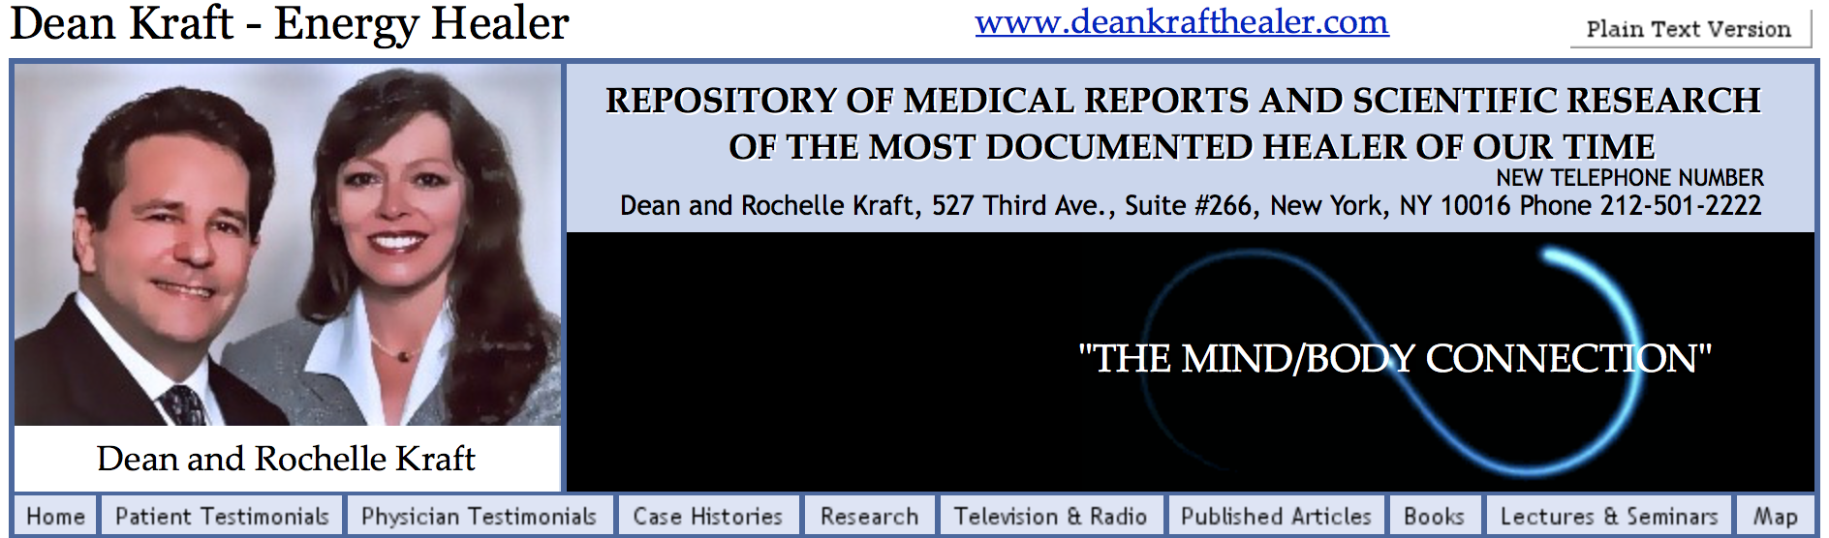
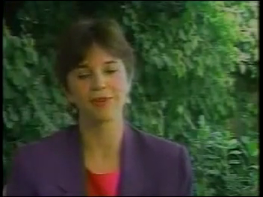
Samantha
She opts for the first two, but declines the research study in favor of pursuing Dean Kraft’s Energy Healing

Slide 5
Definition
Alternative or Off Label Therapy (AOT)-treatment advertised to slow, stop or reverse ALS without good scientific evidence

Slide 6


How Often and Why?
At least 50% of PALS try AOTs
  J Neurol Sci 2001;191:151-4
  ALS 2008;9:257-65
Current ALS treatments and those in foreseeable future may improve quality of life, slightly slow progression
  Neurology 2009;73:1218-1233
  Lancet Neurol 2011;10:481-90
  10% believe they will find a cure, 20% believe they will find something to make them better, 50% believe they will find something to slow progression
    J Neurol Sci 2001;191:151-4

Slide 7
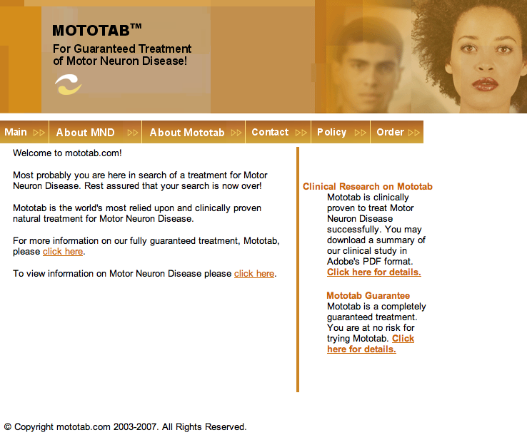
AOTs on the Internet
Many being advertised
  Google search “ALS treatment” >50 million hits
Proponents make attractive claims
  “World’s most relied upon”
  “Clinically proven”
  “Guaranteed”
-http://mototab.com/

Slide 8

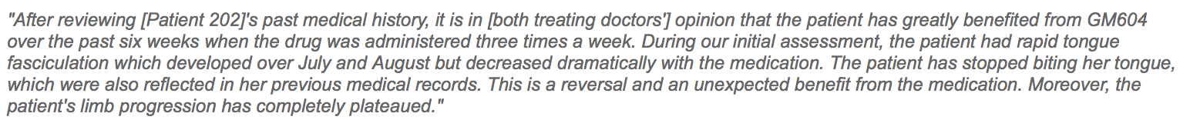
AOTs on the Internet
Anecdotes are the most common type of information used to support efficacy claims
        http://www.genervon.com/genervon/PR20151210.php

Slide 9
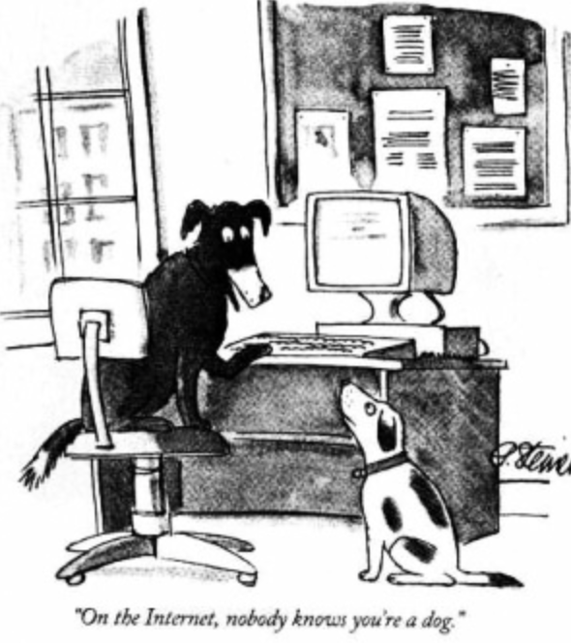
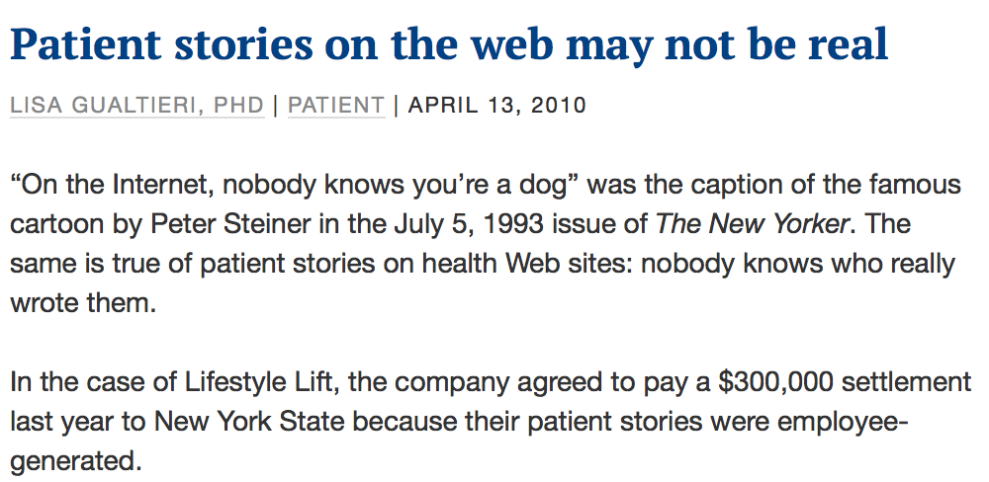
Potential Flaws in Anecdotes
We don’t know who this person is or how their diagnosis was confirmed
  At least 1 example of a company having “made up” anecdotes to sell their treatments
http://www.kevinmd.com/blog/2010/04/patient-stories-web-real.html#more-43464

Slide 10
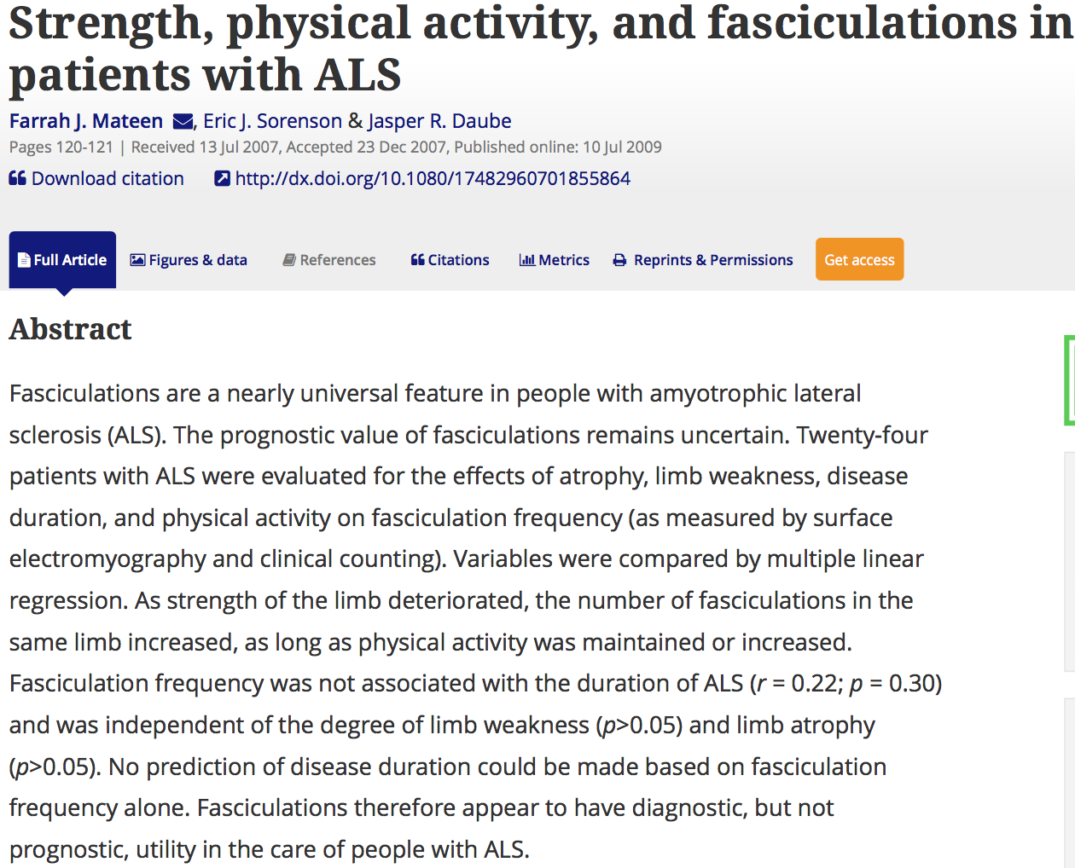
Potential Flaws in Anecdotes
Outcome measures of uncertain clinical significance reported
  Fasciculations not usually bothersome
  Fasciculation frequency not correlated with limb strength or disease progression

Slide 11
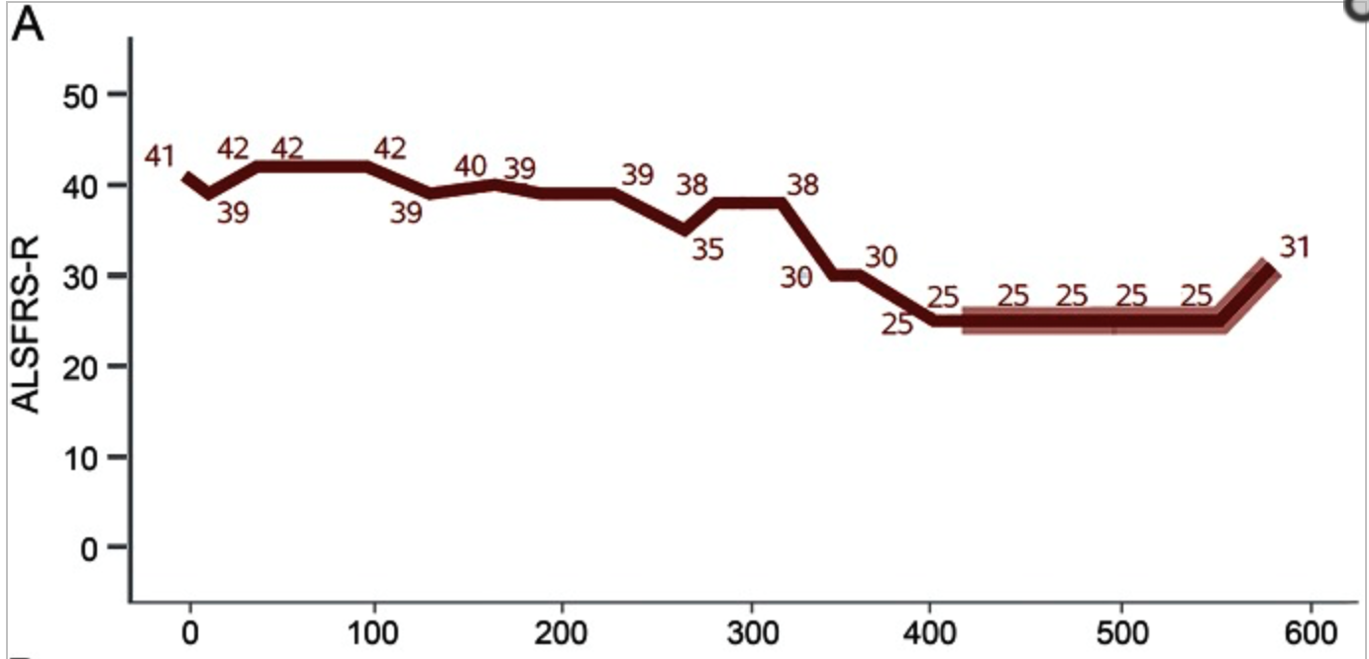
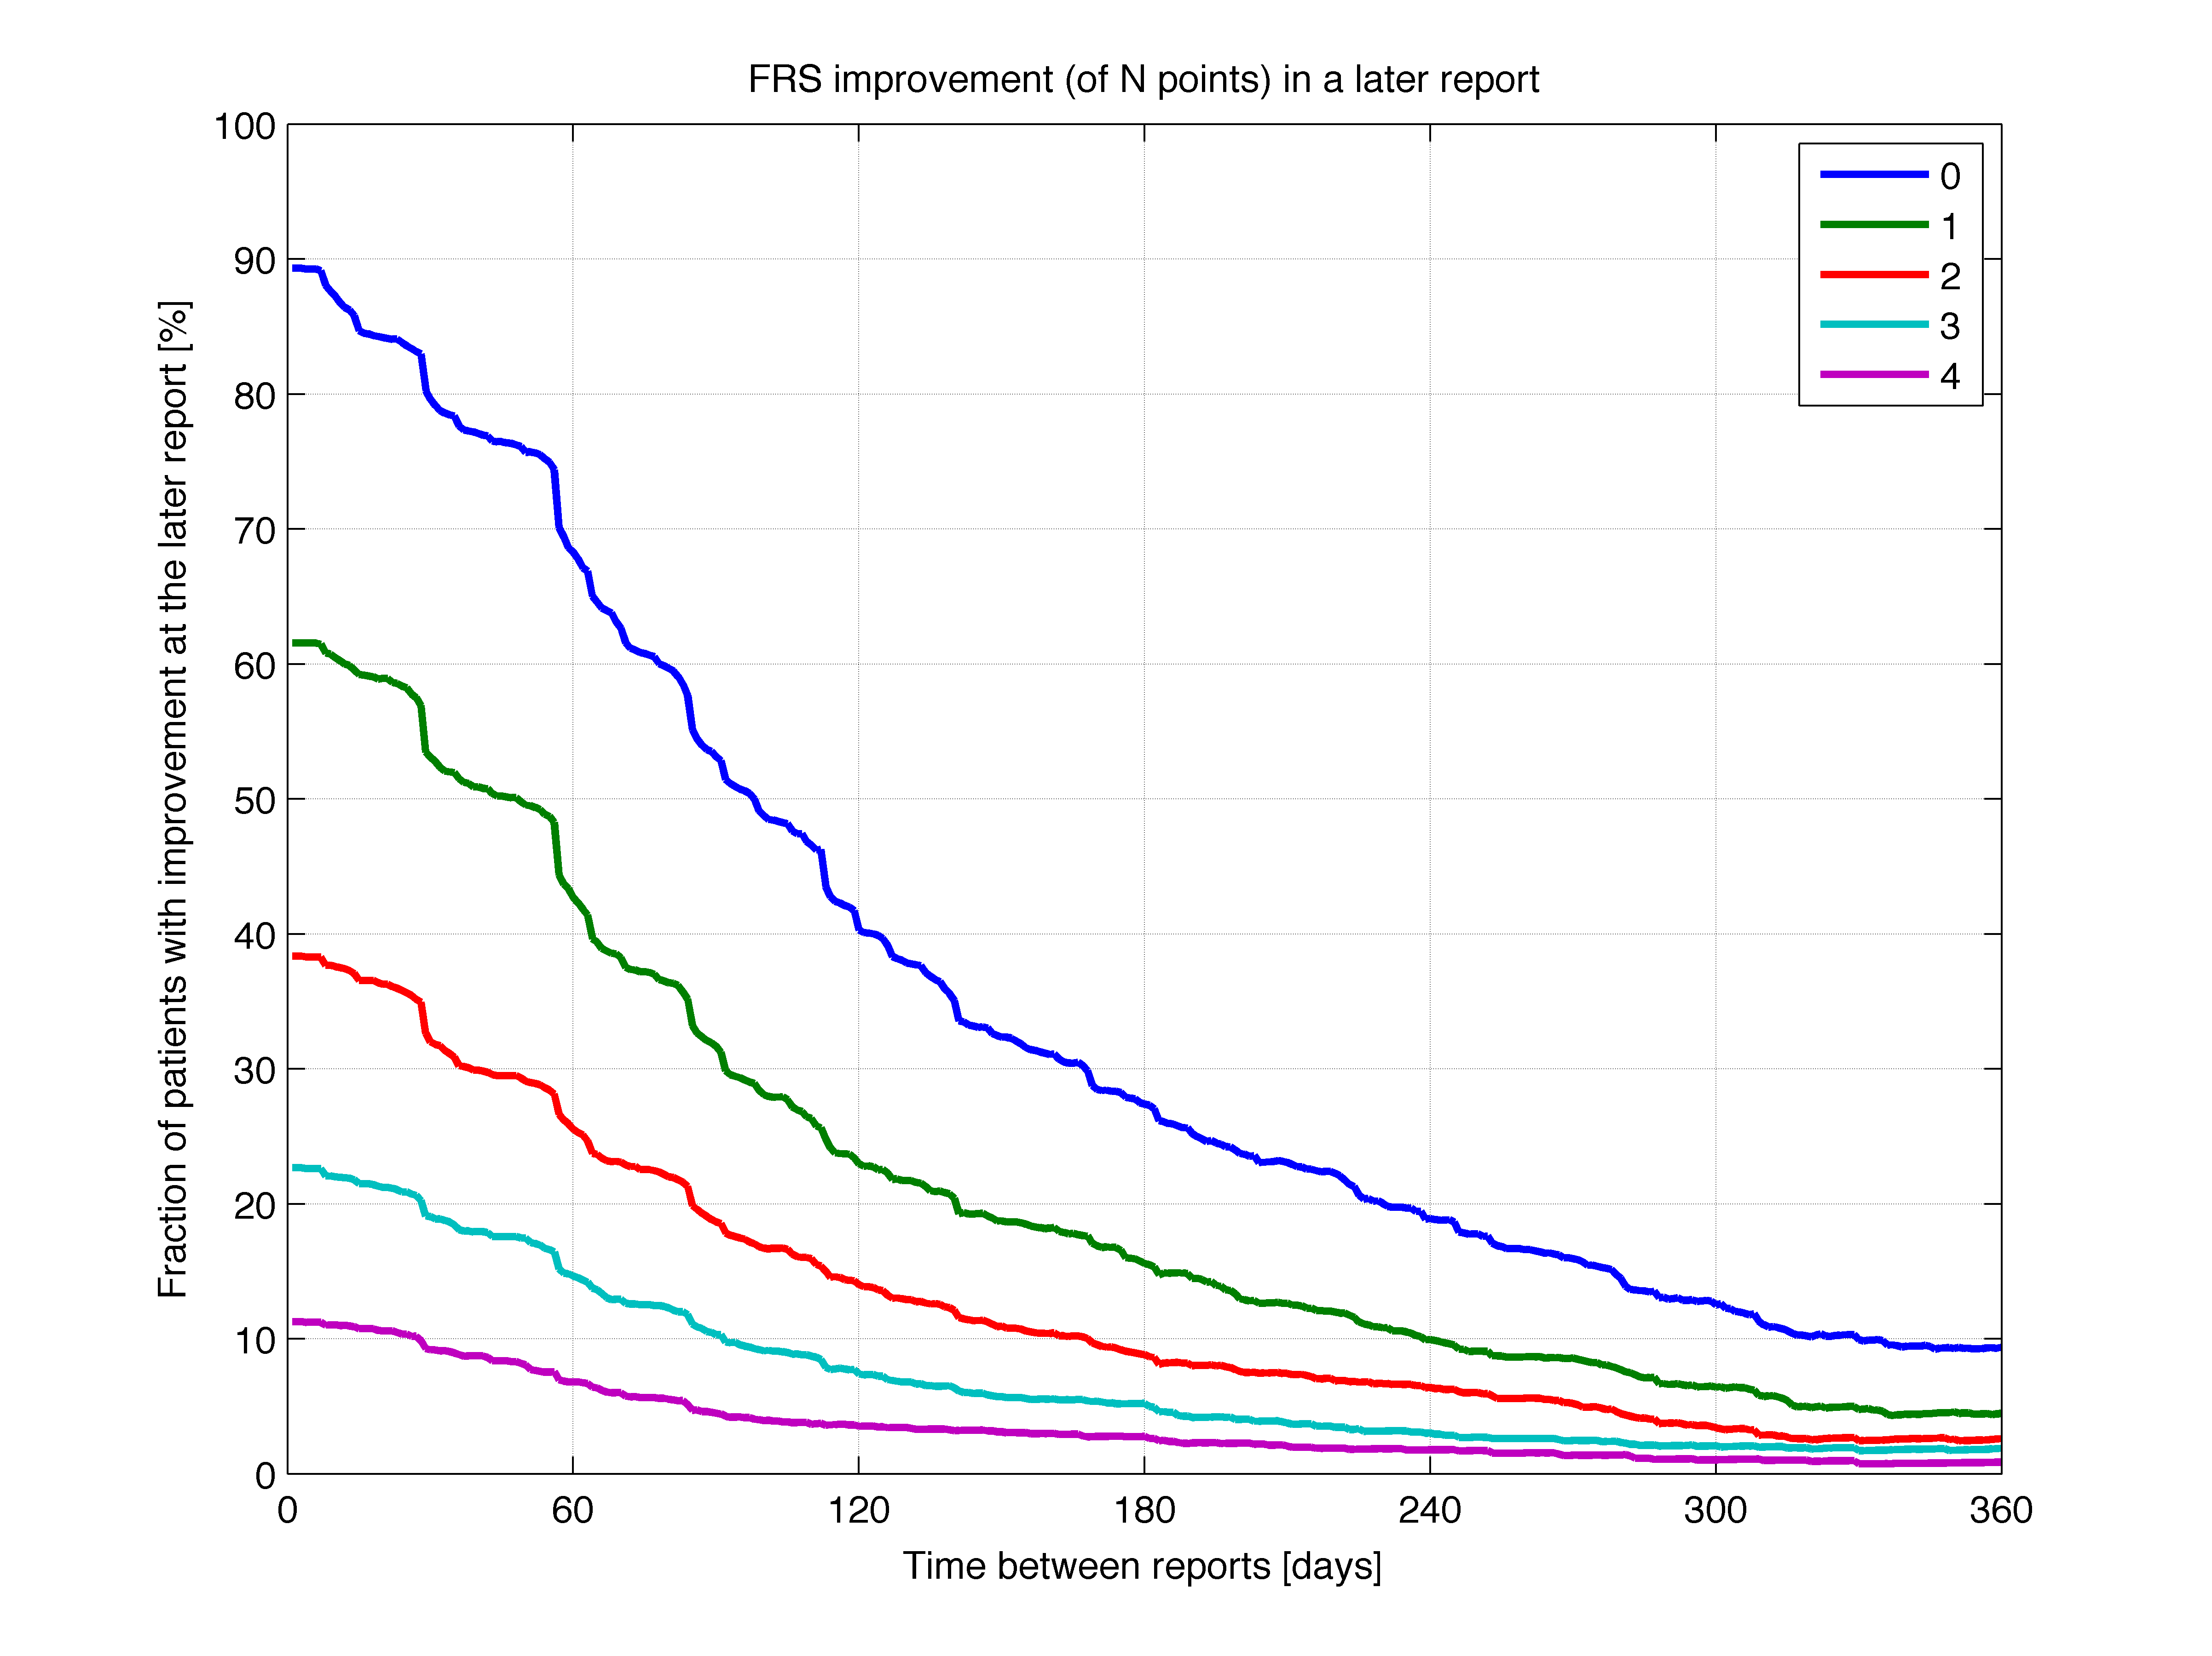
Potential Flaws in Anecdotes
Failure to account for the natural history of the disease
  It is not uncommon for PALS to have periods of stability (plateaus) or small improvements (small reversals)
  75% of participants in PRO-ACT had a plateau lasting 6 weeks at some point in their illness
          Neurology. 2016 Mar 1;86(9):808-12
On Placebo
6 weeks

Slide 12
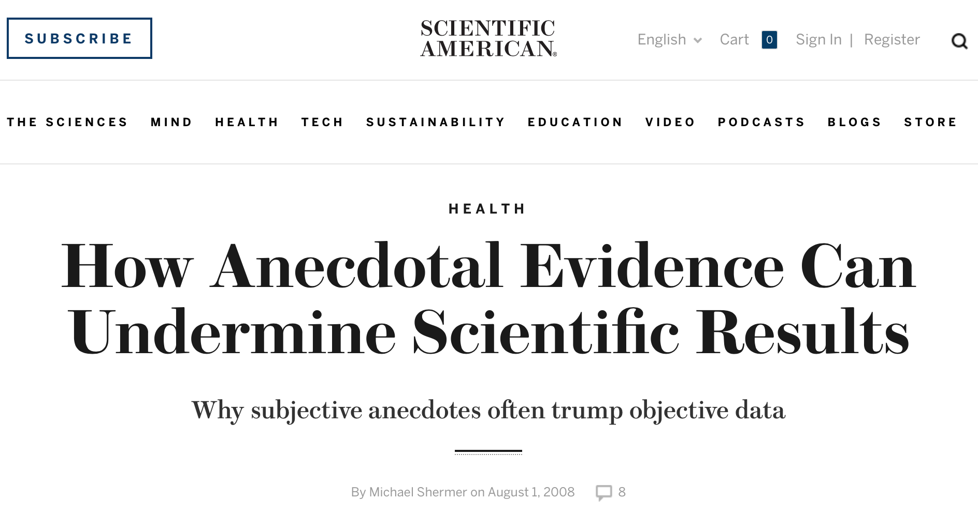
Failure to Recognize Flaws
Common
Why?
“we have evolved brains that pay attention to anecdotes because false positives (believing there is a connection between A and B when there is not) are usually harmless, whereas false negatives (believing there is no connection between A and B when there is) may take you out of the gene pool.”
http://www.scientificamerican.com/article/how-anecdotal-evidence-can-undermine-scientific-results/

Slide 13
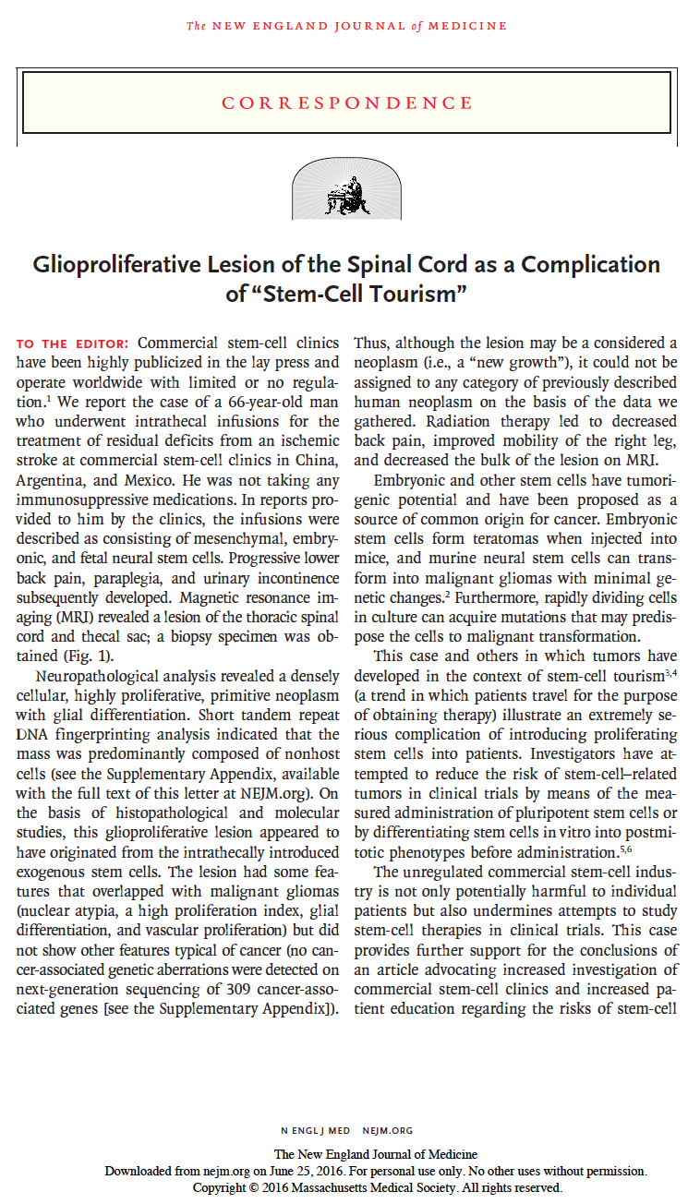
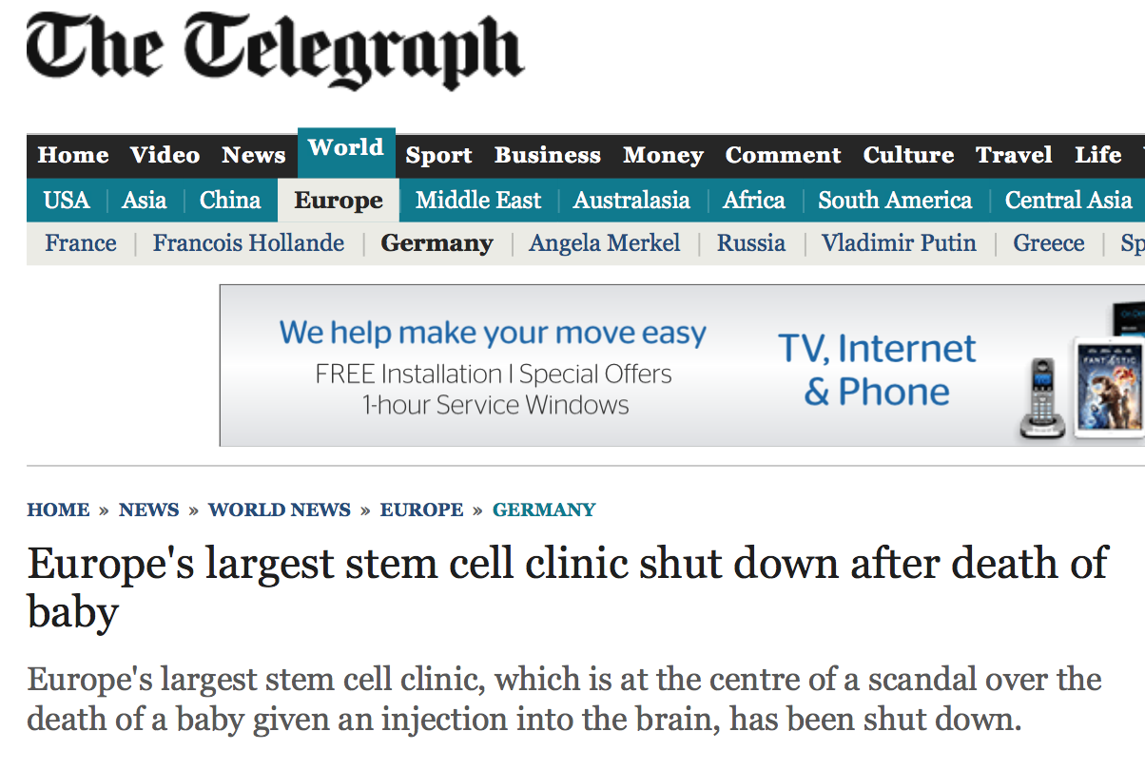
Underappreciated Harms from AOTs
Financial
  AOTs can cost hundreds, thousands, hundreds of thousands of dollars
          Ex. ALS 2010;11:414-416
Physical
  Infections, blood clots, tumors, deaths
          Ex. ALS 2010;11:328-330
Scientific
  Low enrollment rate (2 patients/site/month) in our trials
          ALS 2008;9:257-65

Slide 14
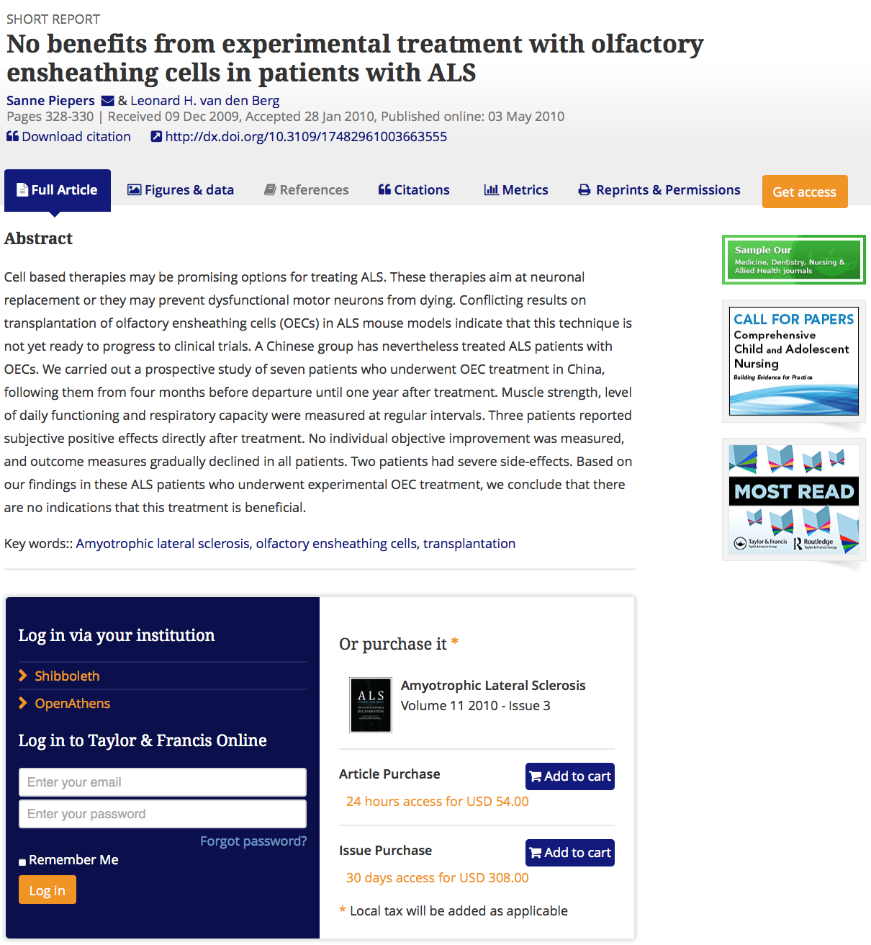
Why Are Harmful Anecdotes Less Influential?
“I already have ALS, what worse could possibly happen?”
Anecdotes describing harm are not as easy for PALS to find
  Reporting bias
  Not on proponents’ websites
  Scattered across many different Internet locations (ex. different chat rooms)
  Scientific literature
    Difficult to access ($$)

Slide 15

ALSUntangled
Started 2009
Goal: develop group of clinicians & scientists that systematically assess AOTs, toward ultimately helping PALS make more informed decisions
Methods
  Inputs
  Investigations/Reviews
  Outputs

Slide 16
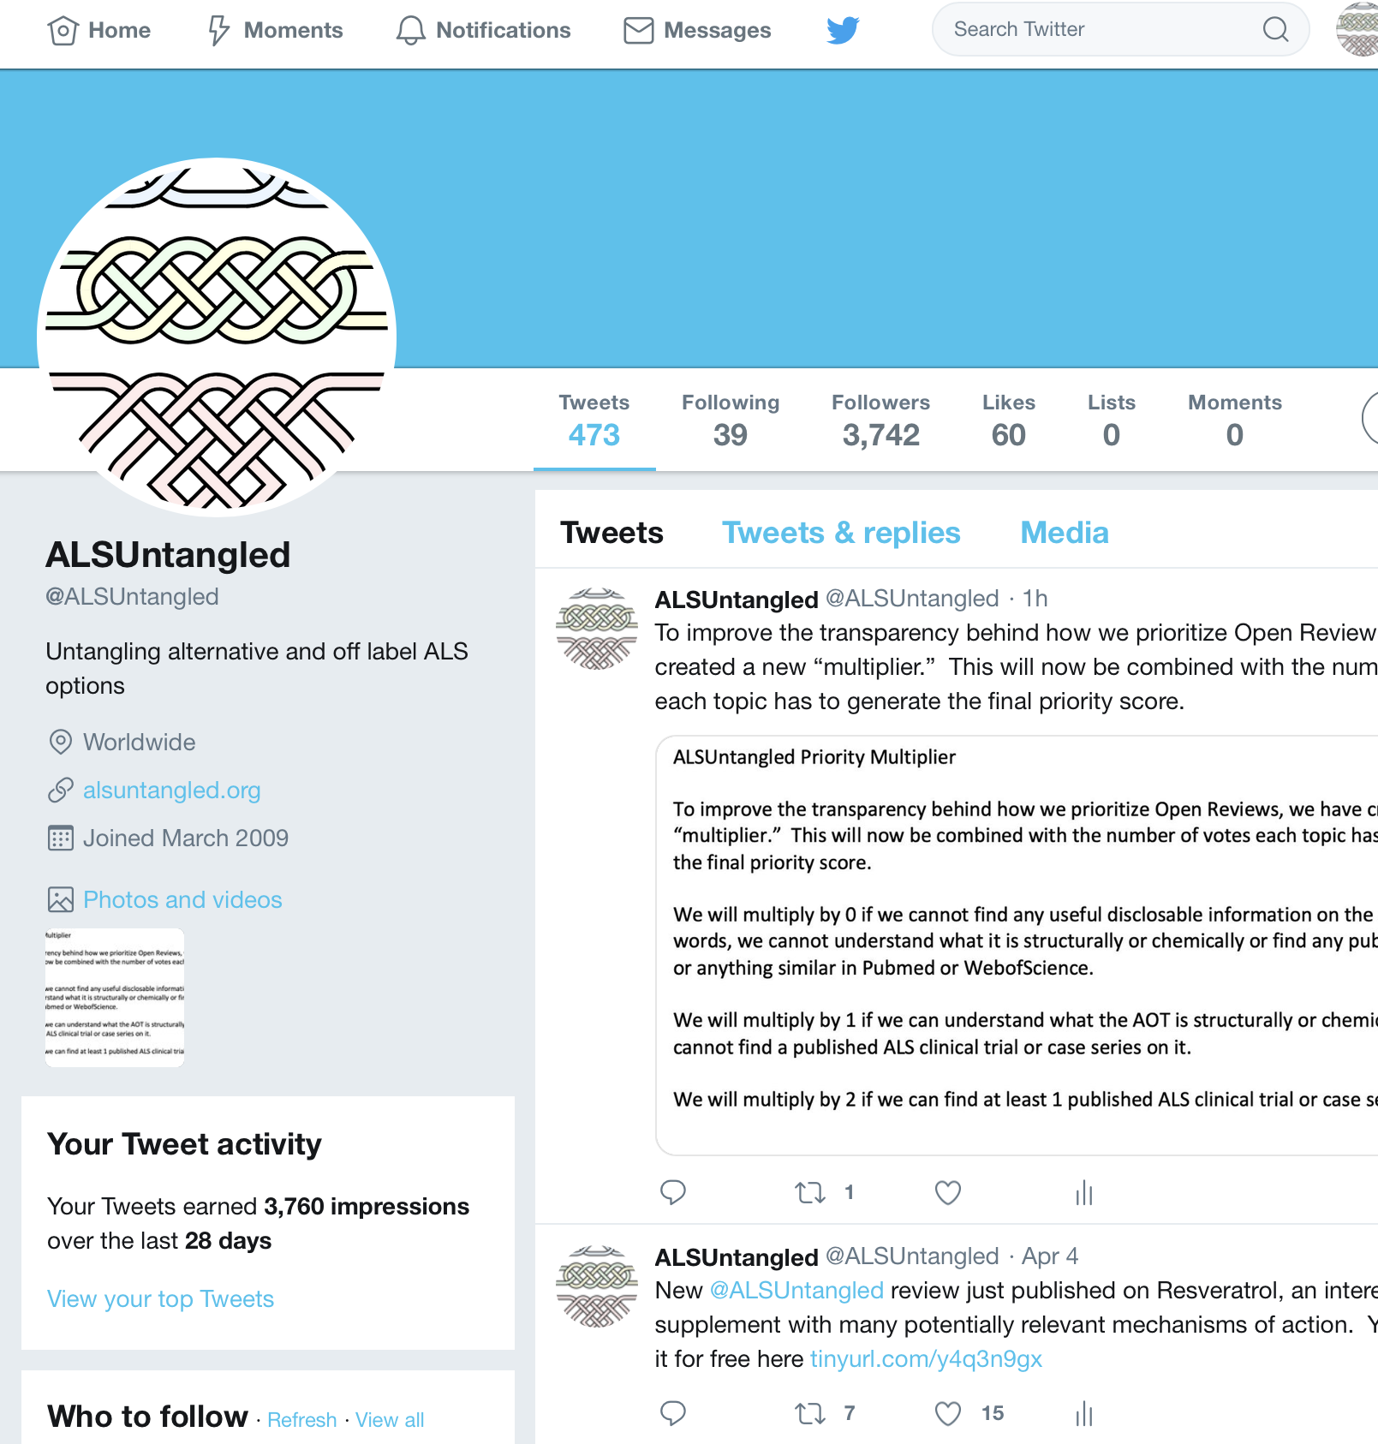
Inputs from PALS, CALS
Face to face visits
Emails with one of our team members
Twitter
  Don’t need to remember specific email address, just key word
  Currently have more than 3,700 Twitter followers

Slide 17
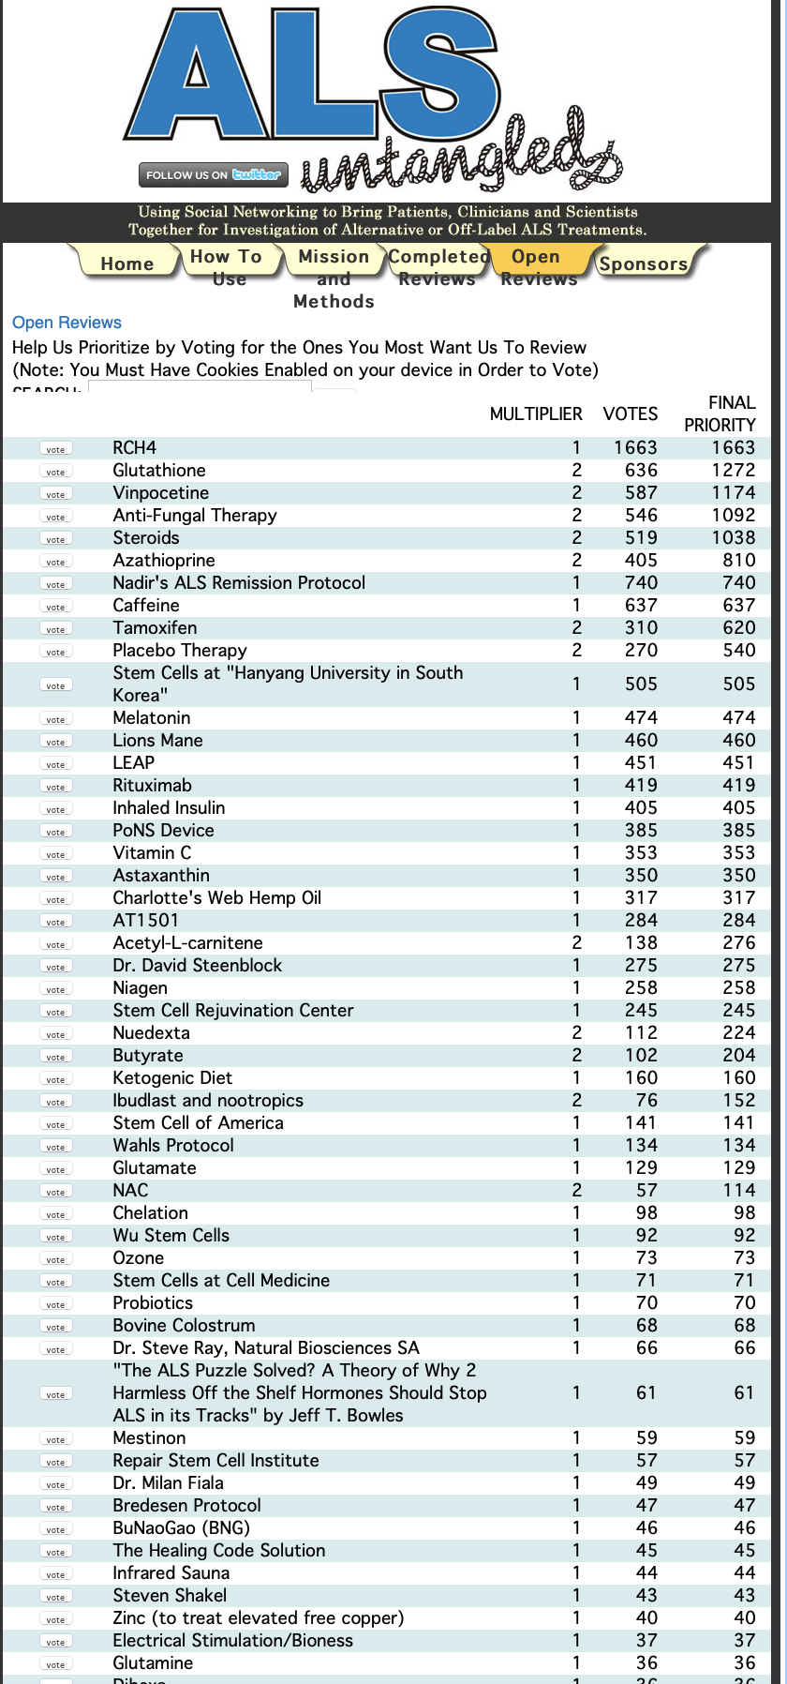
Inputs from PALS, CALS
>400 suggested AOTs, listed on Open Reviews section of our website (www.alsuntangled.org)
Prioritization
  Votes
  Multiplier
    0 if we cannot find any useful disclosable information on the AOT
    1 if we understand what the AOT is but cannot find a published ALS trial or case series on it
    2 if we can find at least 1 published ALS clinical trial or case series on it.
Many Others

Slide 18


Reviews
Team
  >120 members, 10 countries (USA, Canada, Ireland, Israel, Spain, Thailand, Sweden, Poland, France, Russia)
Standard operating procedures (SOPs) guide everything we do, from information gathering to writing, crowd-sourcing drafts

Slide 19
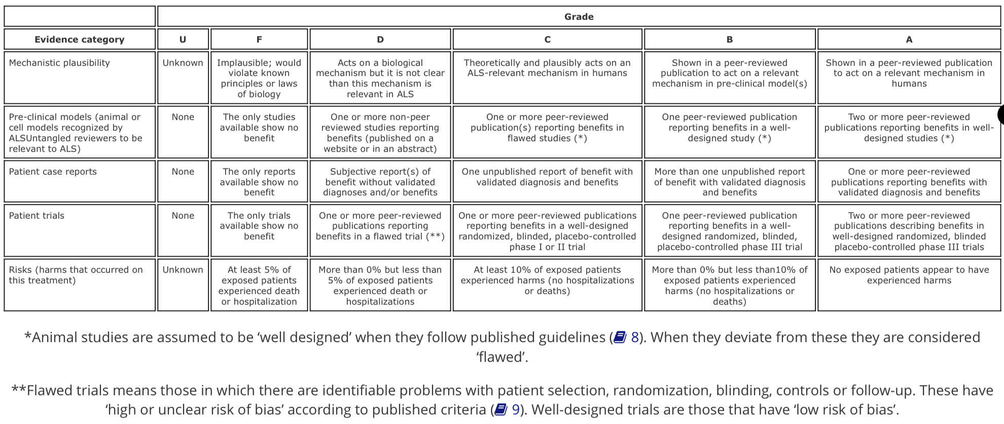
ALSUntangled Table Of Evidence (TOE)

Slide 20
ALSUntangled Table Of Evidence (TOE)
  Can help PALS validate, centralize both positive and negative anecdotes, temper conclusions based on natural history of disease

Slide 21
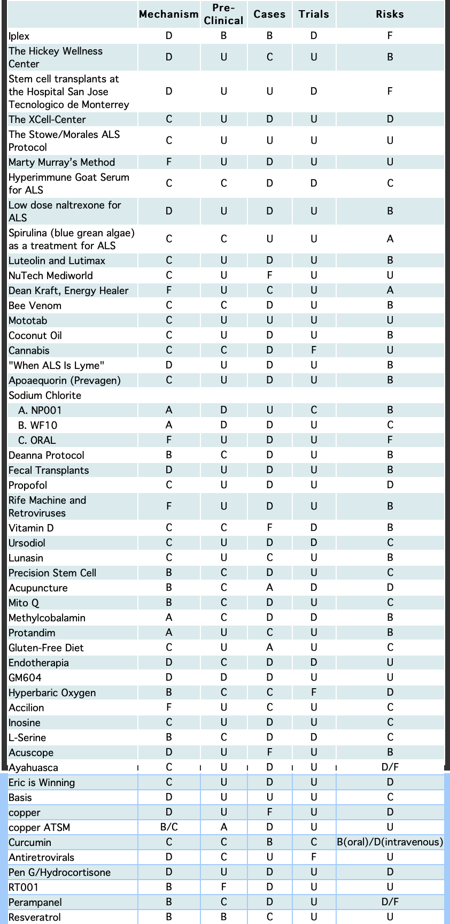
Outputs
Reviews ultimately published in ALS-FTD and under Completed Reviews on our website
  Free to download and read (click on the name and a PDF opens)
  50 published so far
  TOE grades posted for those who want a quick summary
    TOE grade updates from earlier reviews in progress
New podcasts available on partner website (https://www.rarediseasesnetwork.org/cms/create/patients)

Slide 22
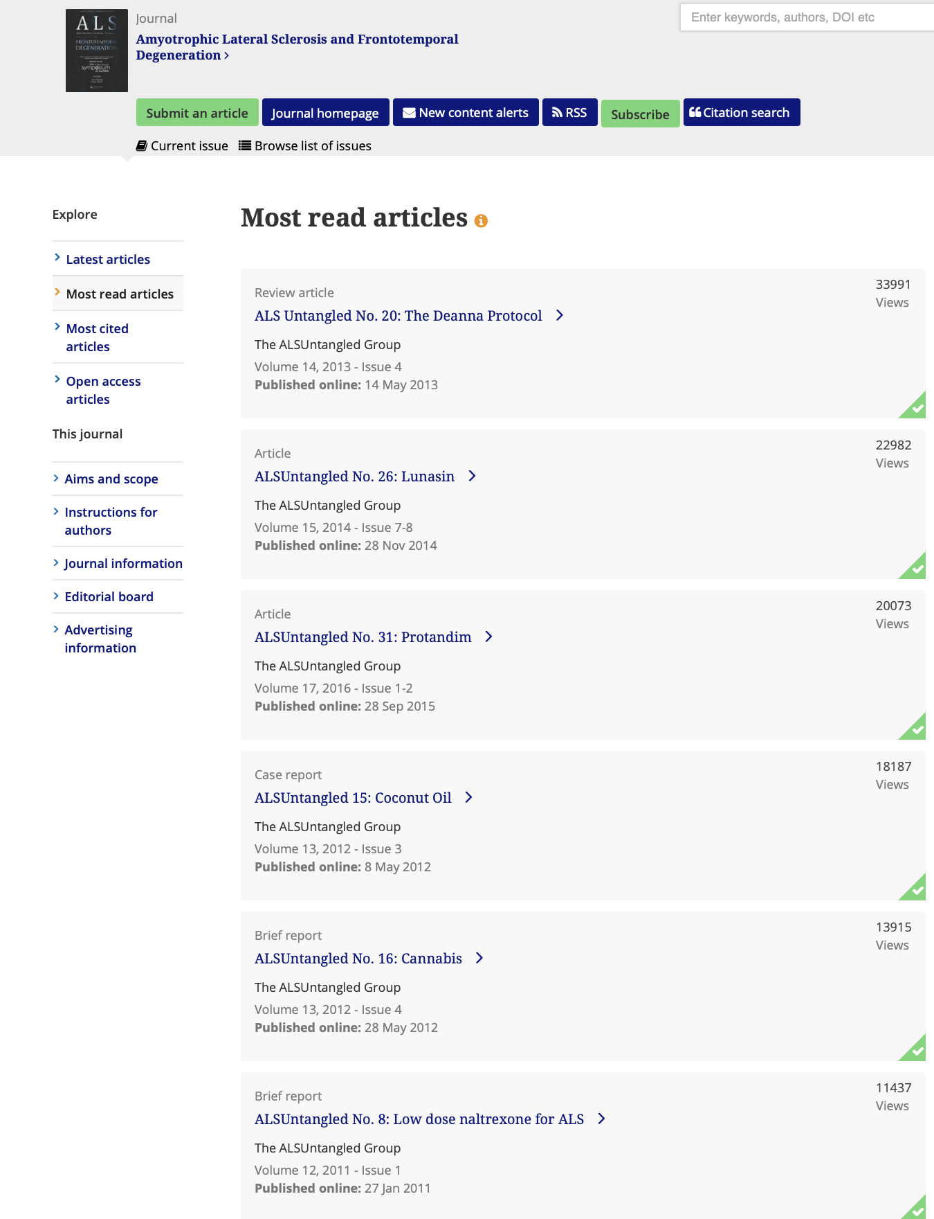
Success?
Each review takes about 40 person-hours to complete
8 of the top 10 most downloaded articles in the history of ALS-FTD
  More than 120K downloads
Podcasts getting hundreds of listens each month
Won AAN 2019 Brainstorm Award for innovative technology that improves patient care

Slide 23
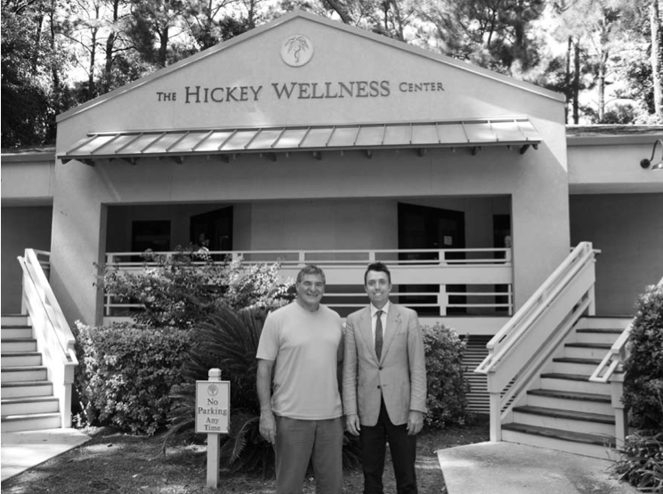
Lessons Learned-Proponents
A few are “snake oil salesmen”
      http://lamesa.patch.com/articles/larry-stowe-sought-on-arrest-warrant-in-texas-inafmous-on-60-minutes
      http://www.cbsnews.com/2100-18560_162-6402854.html?pageNum=7&tag=contentMain;contentBody
      ALS 2010;11:414-416
      http://timesofsandiego.com/crime/2014/05/05/la-mesas-21st-century-snake-oil-salesman-on-60-minutes-gets-6-year-term/
Most are “true believers”
Many have mannerisms that patients appreciate and mainstream doctors can learn from: optimism, respect, responsiveness
Dr. Joe Hickey: A “True Believer”
-ALS2009;10:490-491

Slide 24
Lessons Learned-Treatments
Many AOTs (even some of the strangest sounding ones) actually have plausible mechanisms, and should be studied further
    Lunasin (alters histone acetylation)
    MitoQ (antioxidant which concentrates in mitochondria)
    Protandim (Nrf2 activator)
    L-serine (Blocks BMAA toxicity)
    Coconut Oil (source of ketone bodies)
    Cannabis (modulates neuroinflammation)
    Fecal Transplants (alter microbiome)
    Basis, Resveratrol (sirtuins)
    Several others

Slide 25
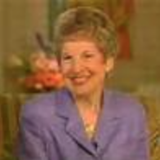
Nelda Buss’ Dramatic ALS Reversal Is Real!
Gradual, painless, limb onset weakness at age 43
Within 6m, unable to walk or accomplish ADLs
Within 12m, quadriplegic and short of breath
No relevant PMH, FH, SH
Seen at UVa (Wooten, Pascuzzi, Phillips)
    Exams showed diffuse arm and leg weakness, pathologically brisk jaw, limb reflexes, normal mental status, cranial nerves, sensation
    2 sets of NCS showed no sensory neuropathy or motor conduction block
    2 EMGs showed progressive denervation and reinnervation cervical, reinnervation lumbar segments
    Cervical myelogram unremarkable
    Blood (ESR, RPR, TSH) and CSF unremarkable
    Diagnosis: ALS
    Stopped seeing doctors after Dean Kraft, but multiple videos show near complete recovery of arm and leg strength (max recovery 2y post nadir)
    www.deankrafthealer.com/Dean-Kraft-Fox-TV-Sightings-May-1-1992.html
    http://informahealthcare.com/doi/pdf/10.3109/21678421.2014.959297

Slide 26
42 Other Examples of Dramatic ALS Reversals
Validated ALS diagnoses, dramatic improvement in at least 1 recognized objective ALS outcome measure
What happened to these people is so different from the natural history of ALS that it warrants further study

Slide 27
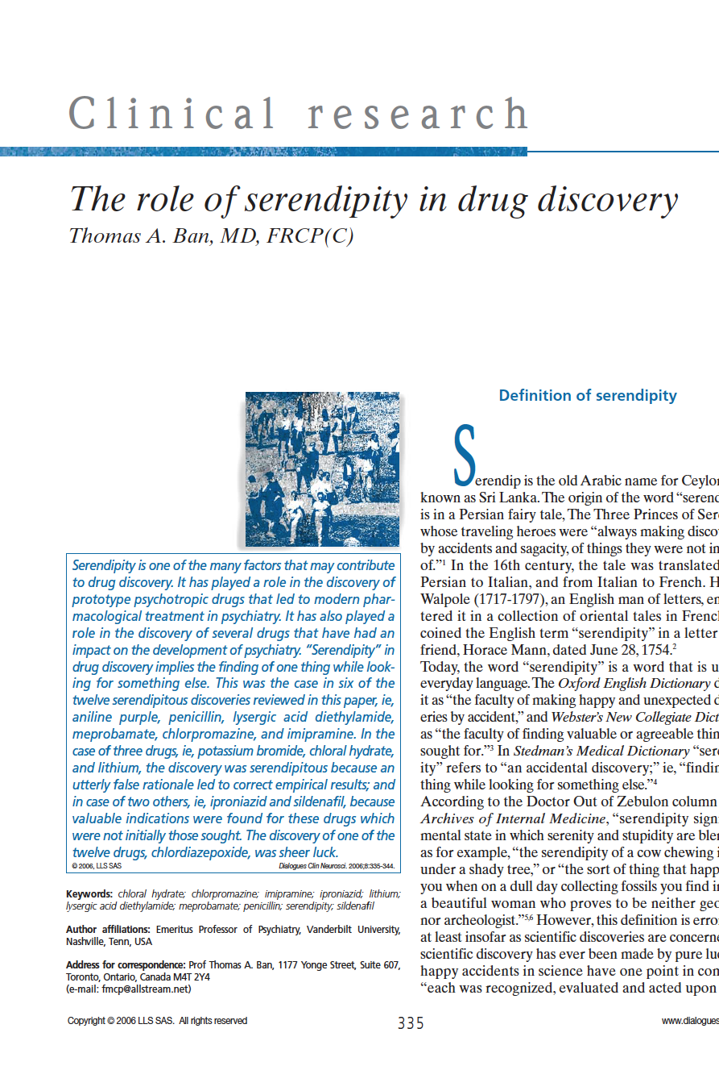
Unexpected and Dramatic Patient Improvement is a Model for Drug Discovery
Example in ALS: Nuedexta
        Neurol Ther 2014;17:15

Slide 28
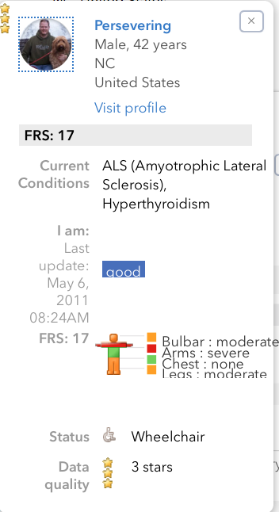
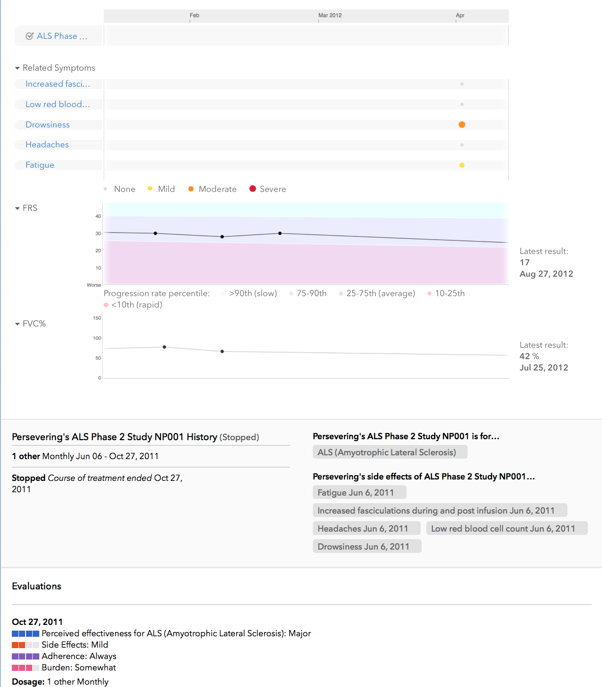
Replication of ALS Reversals (R.O.A.R.)
Small pilot trials of AOTs associated with Dramatic ALS Reversals
  Because most of AOTs are “GRAS” (generally regarded as safe), and because this program is looking for the largest signal ever in an ALS trial (reversal), these can have:
    Wide inclusion criteria
    Lack of placebo control (historical controls)
    Few in person visits (virtual visits)
    Results available in real time (PatientsLikeMe)
    Protocols published (www.alsreversals.org)

Slide 29
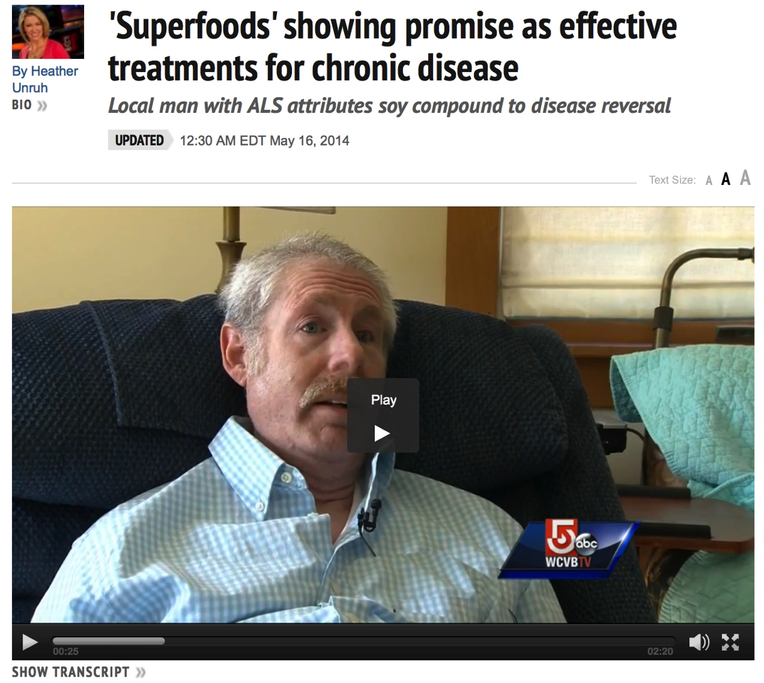
Lunasin
Soy peptide taken orally, reported to have antioxidant, anti-inflammatory, histone-acetylation altering properties (Grade C)
1 patient with MG and validated ALS experienced dramatic and validated improvements in speech, swallowing and limb strength over 1 year on this (Grade C)
  15 others report non-validated improvements
Side effects: very rare (Grade B)
$700/m
The ALSUntangled Group (2014) ALSUntangled No. 26: Lunasin, Amyotrophic Lateral Sclerosis and Frontotemporal Degeneration, 15:7-8, 622-626
http://www.wcvb.com/health/superfoods-showing-promise-as-effective-treatments-for-chronic-disease/26004284

Slide 30
R.O.A.R. Lunasin Trial (Completed)
Bad News
Good News
Lunasin had side effects
No evidence of altered histone acetylation pattern
No evidence of ALSFRS-R slowing
No other ALS reversals
Design worked very well
  Fastest enrolling trial in ALS history (9.1 patients per site per month)
  Diverse study population
  Better retention than most ALS trials (84%)
  Reliable measures, excellent adherence
  Hundreds around the world empowered by published protocol to self experiment with something reasonable
Amyotroph Lateral Scler Frontotemporal Degener. 2019 Jan 21:1-9. doi: 10.1080/21678421.2018.1556698. [Epub ahead of print]

Slide 31
Other Explanations for Dramatic ALS Reversals
Under-recognized ALS mimic?
Potentially fluctuating, antibody-mediated ALS mimics in the literature
  Atypical celiac disease
      Amyotrophic Lateral Sclerosis and Frontotemporal Degeneration, 2016;17:307-309
  Multi-focal motor neuropathy with upper motor neuron signs
      Bedlack RS, Torres S, Pastula D. IVIG-Responsive Upper and Lower Motor Neuron Disease with NP-9 Antibodies, Persisting Long After Infliximab Therapy; in Companion to Peripheral Neuropathy, Illustrated Case Reports Plus. Elsevier (New York) 2010
  Myasthenia gravis with upper motor neuron signs
      Adv Biomed Res. 2015 Feb 23;4:58

Slide 32
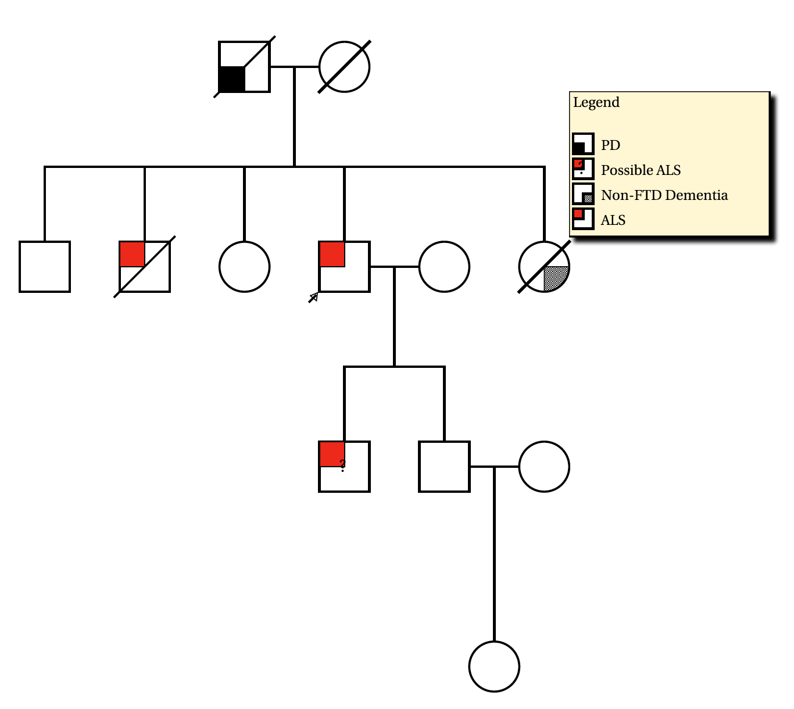
ALS Reversals are Unlikely to be Mimics
Most of our ALS reversals have had extensive work up for mimics
10% of our ALS reversals have a family history of ALS

Slide 33
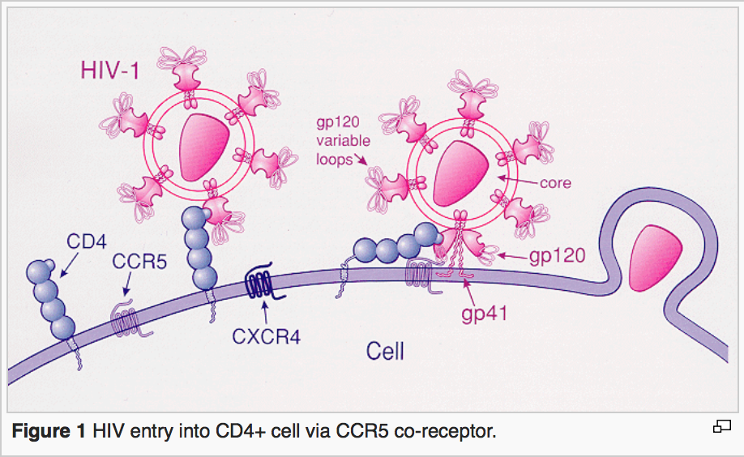
Other Explanations for Dramatic ALS Reversals
Endogenous (genetic) mechanism for “beating” ALS?
Precedent: HIV elite controllers
  1% of those infected with HIV
  Most have mutation called CCR5-Δ32 that impairs viral entry
  Maraviroc (Pfizer) first FDA approved CCR5 antagonist
http://en.wikipedia.org/wiki/CCR5_receptor_antagonist#Drug_development

Slide 34
Other Explanations for Dramatic ALS Reversals
Environmental exposure that somehow ”immunizes” against ALS
Precedents:
  Vaccines (ex. polio)
  Naturally occurring
    Certain childhood infections may protect against future autoimmune disease
      Curr Opin Rheumatol 2009 Jul;21(4):391-6
    Bites from healthy mosquitos may protect against future malaria infection
      Infect Immun 2007 May; 75(5): 2523–2530

Slide 35
Study of ALS Reversals (St.A.R.)
Find more Dramatic ALS Reversals
Advertising on traditional and social media
Getting records to confirm diagnosis and dramatic, improvement in objective measurement
Enter them all into the same database
Compare demographics, disease characteristics, co-morbidities, AOTs to PRO-ACT and National Registry participants
Get blood samples on as many as we can
Genetics, possibly downstream biomarkers
Ask them questions about exposures

Slide 36
Compared to PALS in Databases…
ALS Reversals are
  Younger
  More likely to be male
  More likely to have limb onset disease
  Progress faster before they start to improve
  More likely to have taken certain AOTs (ex. curcumin)
    Amyotrophic Lateral Sclerosis and Frontotemporal Degeneration, DOI: 10.1080/21678421.2018.1457059
  More likely to have been carpenters or cabinet makers
    Presented at AAN meeting, May 2019

Slide 37
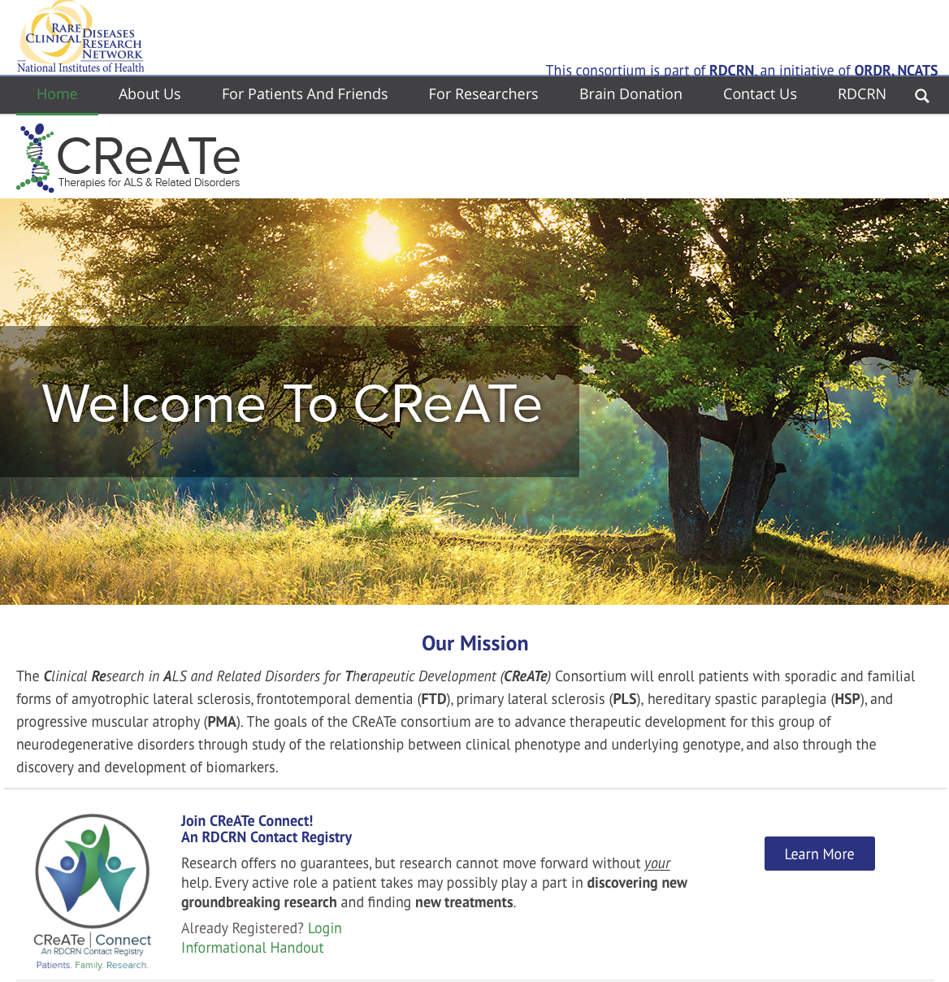
St.A.R.-Genetics
Samples collected
Will be collaborating with CReATe Consortium to perform whole genome sequencing, compare to patients with more typically progressive ALS
  You may be able to participate in this and other CReATe studies; sign up for CReATe Connect to be kept informed

Slide 38
Conclusions
When it comes to AOTs, “The Truth Is Out There” but it isn’t always easy to find
    Anecdotal data is especially problematic in ALS, commonly misinterpreted
ALSUntangled uses social networking to bring PALS, clinicians & scientists together to systematically review and report on AOTs
  Can help validate, centralize both positive and negative anecdotes, temper conclusions based on natural history of disease

Slide 39
Conclusions
Dramatic ALS Reversals can occur and warrant further study
    R.O.A.R. (pilot trials of agents associated with dramatic ALS reversal)
      Trial of Lunasin complete, design a success
    St.A.R. (search for under-recognized mimics, endogenous mechanisms for beating the disease)

Slide 40
Thanks
PALS
ALSA, MNDA, LVH ALS Foundation and all of our other funding sources
PatientsLikeMe, Neurobank, Origent, ALSUntangled reviewers
Duke ALS Care Team

